Slide 1
In this course, you will gain a deep understanding of a highly advanced technology that enables seamless conversational transactions between your users and your company, comparable to a well-engineered system designed to transmit energy efficiently between multiple components.
You will explore modern artificial intelligence (AI), which functions like a thermodynamic engine, transforming the input of real-time enterprise data into the output of meaningful customer interactions. This AI allows non-developers to build tools that connect to your enterprise’s data infrastructure and deliver dynamic, user-facing services across various platforms whether over the phone, web, or communication interfaces like Teams, Slack, or WhatsApp.
Consider the process of a user performing actions like paying bills or applying for a loan, analogous to mechanical work in a system. Just as torque represents the force that drives rotational motion in a machine, AI assists in driving these transactions with precision. The AI engine processes user inputs (e.g., questions about loan types or resolving a billing error) and provides real-time responses by tapping into powerful Large Language Models (LLMs), much like a heat engine drawing on available energy to maximize efficiency.
Welcome to Building an AI Assistant using IBM watsonx Assistant. This course guides you through the core engineering principles behind AI Assistants.
In this course, explains concepts with the assumption that you, as a Subject Matter Expert (SME), understand the customer interaction "load" much like an engineer understands the forces and stresses acting on a machine. Whether your domain is a call center, banking, or customer support, you are familiar with the "torque" requirements the challenges and needs customers present and how to deliver optimal "output" (solutions) for successful conversational transactions.
The use cases of Watsonx assistant are first Responders, banking and RegTech.
As this is an introductory course, the focus is on business users, similar to understanding the basic design principles of a mechanical system. You don't need technical expertise in AI or machine learning; rather, your expertise in understanding customer needs serves as the primary driving force, or input energy, that the AI system will amplify and respond to.

Slide 2
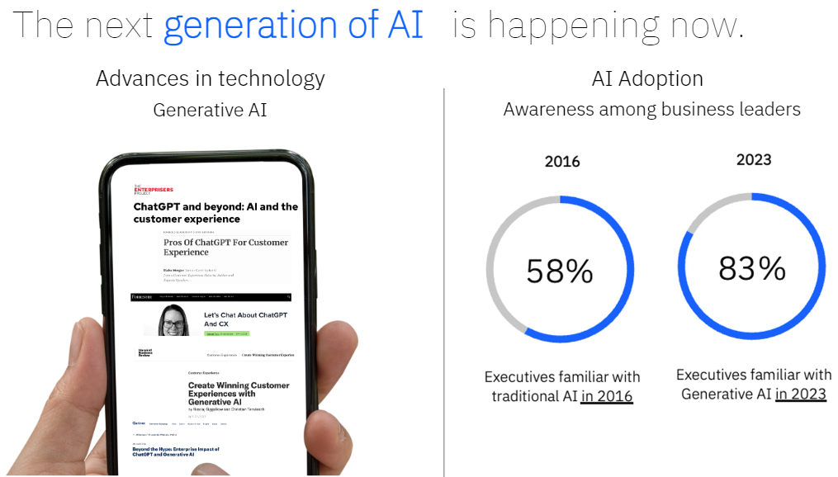

Slide 3
Throughout this course, we will use several key engineering-related acronyms:
SME (Subject Matter Expert): The domain expert who understands the "load" or demand from customers, much like an engineer calibrates machinery based on external forces and user requirements.
AI (Artificial Intelligence): The "engine" of the system, covering areas like machine learning and natural language processing, which converts data into actionable insights.
ML (Machine Learning): The "algorithmic mechanics" that process data to generate insights, similar to how a machine optimizes performance through precision engineering.
LLM (Large Language Model): These models are the deep learning "powerhouses" that enable real-time, natural language responses, analogous to an advanced motor adapting to variable load conditions.
Upon completing this course, you will have the capacity to:
Grasp the terminologies and technologies powering AI, much like understanding the components of an engine.
Analyze various operational use cases, similar to evaluating a system's performance under different loads.
Evaluate the capabilities of an AI Assistant with the same precision used to test the torque and efficiency of a mechanical system.
Apply your knowledge to load, configure, and fine-tune an existing AI Assistant, similar to calibrating machinery for peak performance.
Assess deployment strategies that align with your company's needs, just as an engineer chooses the most efficient method of energy transfer for a particular application.
IBM has been a global leader in technological innovation for over 100 years, much like a foundational engineering firm. Back in the 1950s, IBM pioneered the development of one of the first chatbots, comparable to the birth of the Autonomic Computing Initiative, a precursor to today's AI, which laid the groundwork for advancements in the field much like early breakthroughs in thermodynamics paved the way for modern engines.
By the end of this course, you’ll be equipped to engineer AI-driven customer solutions, ensuring smooth conversational interactions much like designing a machine to maximize efficiency and output under varying load conditions.

Slide 4
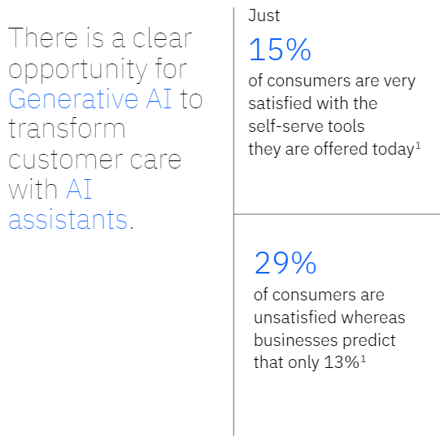

Slide 5
The IBM 7094, a powerful mainframe system spanning approximately 300 square feet, served as the computational engine for the IBM Autonomic Computing Initiative. From an engineering perspective, we can liken its operations to the basic principles of thermodynamics in a closed system, where the energy input was the computing power, and the output was the simulation of human-like conversation.
The system was designed to mimic a particular type of psychologist, rephrasing a patient's statements into questions, similar to a machine achieving mechanical work by transferring input energy into output motion.
However, much like low-torque machines that perform repetitive, low-effort tasks, the Autonomic Computing Initiative didn’t truly "understand" the patient’s words.
Instead, it relied on simple pattern matching and substitution algorithms, resembling the basic mechanical operations of a system constrained by minimal external forces.
Just as a machine with low torque handles limited resistance, this early chatbot could only process predefined, linear tasks that gave the impression of real dialogue without achieving any deeper level of comprehension.
In 2010, DARPA's research in conversational systems, analogous to a breakthrough in material science allowing for more efficient energy conversion, was made public. This catalyzed the growth of smart devices like phones, speakers, and appliances that integrated basic conversational assistants, parallel to low-friction mechanical systems performing simple tasks efficiently.
Around 2016, web messaging platforms integrated chatbots with the intention of increasing session "stickiness." This can be likened to increasing the inertia in a mechanical system, users were more likely to stay engaged as the interaction maintained their momentum, keeping them clicking and exploring the site.
These early systems were rudimentary, performing basic actions such as turning on lights or adjusting thermostats, much like a basic motor performing repetitive tasks with minimal variation in torque or output.

Slide 6
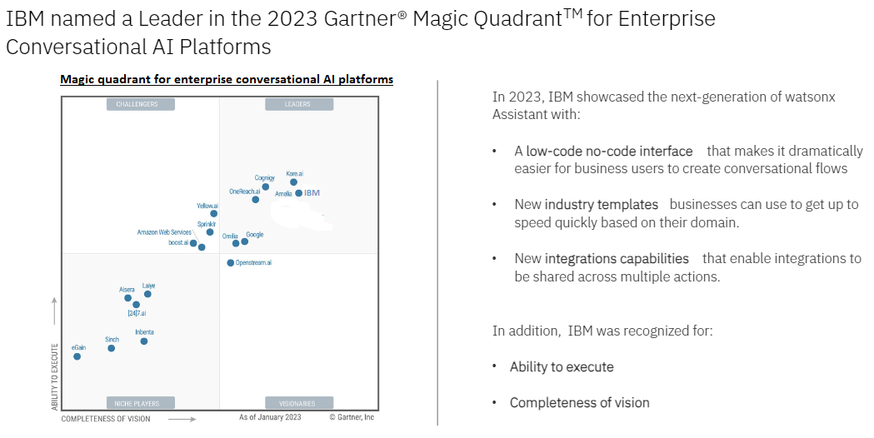

Slide 7
In today’s landscape, question and answer chatbots continue to evolve, becoming more complex as they are integrated into modern devices and systems. These bots are designed for simple, static queries such as "What are your store hours?“ ,tasks analogous to steady-state operations of a low-torque machine that repeats predefined functions under specific conditions. However, modern AI assistants, particularly those powered by IBM's watsonx Assistant, represent a leap in capability, similar to machines designed with variable torque output capable of handling more complex and dynamic operations.
When a query cannot be matched to a static answer, these assistants utilize advanced Large Language Models (LLMs) to dynamically generate responses, much like how variable-speed motors adapt their torque to match changing load requirements. IBM’s Intelligent Virtual Agents (IVAs) further extend this analogy by functioning as multi-stage, high-torque systems that can orchestrate complex, multi-system tasks. These agents operate across various deployment platforms such as bare metal, hybrid cloud, edge computing comparable to a highly adaptable engine that can perform efficiently across different operating environments.
An IVA doesn't simply engage in a predefined sequence like a chatbot; it integrates diverse enterprise data sources much like a complex machine pulling inputs from multiple energy sources with the aim of creating a highly personalized and dynamic user experience. IVAs can access CRMs, user databases, and marketing platforms to deliver results tailored to each user’s unique context, analogous to an advanced mechanical system adjusts its operation based on real-time feedback and varying load conditions.
IBM's Intelligent Virtual Agents stand out due to their accessibility for business users. No specialized knowledge of machine learning, natural language processing, or AI is required, much like a machine that delivers high performance without demanding detailed knowledge of its internal mechanics. The key requirement for the SME is the ability to communicate effectively and lead customers through seamless interactions, ensuring a successful outcome analogous to an engineer calibrating a machine for optimal output efficiency.
In summary, IBM's conversational AI systems have evolved from basic, low-torque operations mimicking simple dialogue into complex, high-torque solutions capable of executing sophisticated tasks across multiple systems, providing businesses with unparalleled flexibility and user experience capabilities.

Slide 8
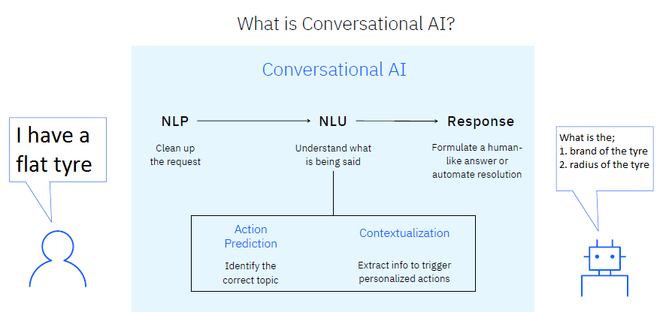

Slide 9
When conversational assistants were first introduced, they were referred to as "chatty bots" and later as "chatbots." However, with the advancements in technology and capabilities, these systems now resemble a high-efficiency machine, complete with dynamic feedback and enhanced output control.
Thus, the term "Intelligent Virtual Agent" (IVA) is more appropriate, much like how early "horseless buggies" evolved into "cars" once their functionality, speed, and design surpassed the initial constraints of their early form.
The skills required in order to build an IVA is knowing the domain of your company and how users get problems resolved.
Built-in analytics in an IVA show how to compare IVAs in different environments and if there are any blockers that stop people from successfully completing their personal needs
ChatGPT
By now, you're likely familiar with ChatGPT, a general-purpose chatbot that attempts to cover the full “electromagnetic spectrum" of AI, from writing novels to replacing human roles in the workplace. ChatGPT operates similarly to a basic motor that can drive simple tasks in a variety of directions. However, it lacks the precise "torque" and "load distribution" required for domain-specific, enterprise-grade applications.
Many companies have attempted to leverage ChatGPT’s potential, but it’s like using a low-friction engine without the necessary fine-tuning to maintain reliability and safety under higher operational loads.
Watsonx Assistant, on the other hand, is engineered to provide reliable and controlled output, especially under heavy enterprise demands. Think of it as a finely-tuned high-torque motor that delivers consistent, accurate results under fluctuating loads.
Challenges with ChatGPT
The friction arises when ChatGPT tries to process incorrect or outdated data, causing significant "slip" in its output, analogous to an engine losing efficiency due to misalignment or insufficient fuel.
For example, ChatGPT may falsely claim, "The Webb telescope took the first photograph of a planet outside our solar system," when in reality, this was done in Chile in 2017. This is analogous to an engine overheating due to improper fuel mixture or an unstable energy source.

Slide 10
ChatGPT’s dataset is also problematic for enterprises. Its "fuel" consists of broad, uncurated, and outdated data. It’s not even the latest information from the web, and businesses don’t have touch-access to its underlying data.
As such, this AI model is like a machine working with suboptimal materials, limiting its operational efficiency and increasing the chances of "system failure."
Moreover, ChatGPT’s neural network model is inaccessible to the end user, limiting control over its performance and tuning. Imagine trying to fine-tune an engine, but the internal components are sealed, leaving no room for critical adjustments. Watsonx Assistant, by contrast, offers a wide selection of LLM models, giving businesses the flexibility to select the right "torque" for specific tasks and environments.
In the context of IVAs, merging text and voice can be summarised that a user can choose to switch between voice and text.
Limitations of ChatGPT
ChatGPT is not currently equipped with orchestrations or integrations to third-party systems. This lack of integration makes it comparable to a machine without the ability to couple with additional components, limiting its range of motion and functionality.
Furthermore, ChatGPT’s tendency to "hallucinate" (a term popularized by Google in 2018) is like an autonomous car which is programed to drive east but instead the steers to the west. Hallucinations can generate plausible but entirely inaccurate outputs, posing a risk to any mission-critical applications.
In contrast, watsonx Assistant is akin to a robust, fully integrated machine, designed to operate smoothly in both front-end and back-end systems. On the front end, it connects with multiple "channels" such as phones, SMS, or Facebook, like a powertrain capable of delivering torque to multiple outputs.
On the back end, it connects with any REST-based application, ensuring access to real-time enterprise data much like a well-lubricated machine pulling input from various sources, free from unnecessary friction or energy loss.
Watsonx Assistant offers precise control over LLM selection, tuning, and safe operation by setting guardrails, ensuring "load balancing" across enterprise systems. Its ability to perform semantic searches across structured and unstructured enterprise data is similar to optimizing the energy efficiency of a thermodynamic system through constant feedback and adjustment.

Slide 11


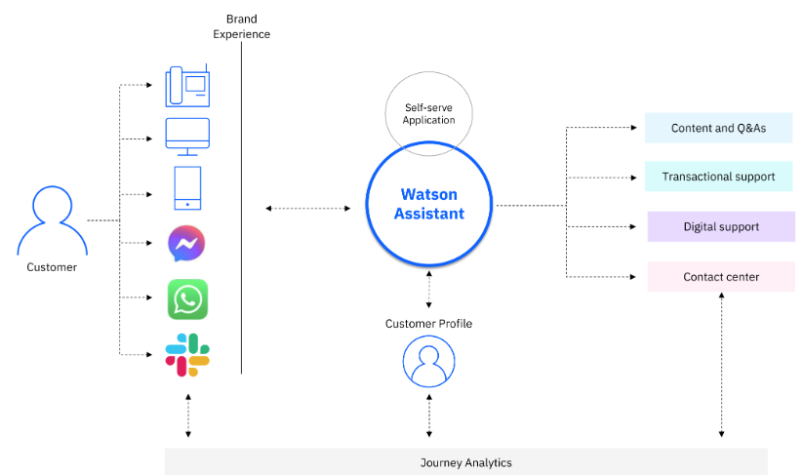
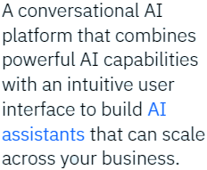

Slide 12
Data privacy and legal compliance
In today's world, data serves as a critical fuel source, much like how energy powers a machine. Companies must carefully monitor how data is "collected, processed, and protected“, especially in highly regulated industries, where data security is similar to heat loss in thermodynamic processes. A poorly insulated system loses energy, just as improper data management can result in legal vulnerabilities.
As technology evolves, bad actors constantly seek new vulnerabilities, much like friction wears down machine parts. New laws and regulations such as the HIPAA, FERPA, and GDPR continuously emerge to mitigate this risk.
Legal professionals are required to stay up to date with these changes, which is why Thomson Reuters used Watsonx Assistant to develop an intelligent virtual agent specialized in legal research. This agent functions like a precision engine that ingests legal documents, learns from them, and performs legal analyses, ensuring that "friction" (or legal liabilities) is minimized.
For instance, if the query is "Does Australian law require regulator notification of a data breach?" the virtual agent can comb through up-to-date legal documents to provide an accurate response, similar to how a sensor-based system reads and adjusts to real-time conditions.
The system continuously ingests and processes new data, adjusting its knowledge base, much like a machine recalibrating its parameters for optimal performance.

Slide 13
Banking example
Historically, AMRO's customer service relied on human operators, which posed scalability issues much like a low-torque motor straining under heavy loads.
However, with the advent of virtual agents powered by watsonx Assistant, these systems are now scalable, automated, and highly efficient just like upgrading to a high-torque engine capable of handling variable loads with minimal wear and tear.
In summary, watsonx Assistant represents a leap in AI technology that can integrate seamlessly across platforms and applications, allowing businesses to operate with the precision of a finely tuned mechanical system.
By maintaining complete control over their data, models, and operational parameters, companies can ensure the smooth and secure functioning of their customer interactions, just like an engineer fine-tuning a high-performance engine for maximum efficiency.
Every tax season, AMRO faced significant operational inefficiencies due to a surge in call volume. This seasonal spike in customer demand led to long hold times, much like an engine operating under extreme load, generating excessive friction and thermal stress.
The bank's initial strategy was to scale up and down its workforce, analogius to adjusting the size of a machine to handle variable torque loads. However, this solution lacked efficiency and incurred substantial overhead.
To reduce operational strain, AMRO implemented "Anna", a virtual agent powered by watsonx Assistant, a move akin to installing a self-regulating system capable of absorbing and redistributing the load.
Anna now manages 85% of the bank's call volume, regardless of seasonal fluctuations. Just as a finely tuned engine provides consistent performance under varying conditions by minimizing heat loss and reducing friction, Anna offloads repetitive tasks, allowing human agents to focus on high-value, complex work.
The reduction of "friction" between customer interactions and the bank's service infrastructure is significant.
The reasons for being able to create up to five different environments are to ensure a streamlined testing process and collaboration across teams.

Slide 14
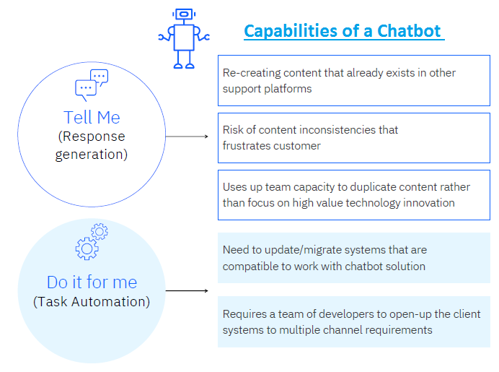

Slide 15
Anna’s Impact on Customer Interaction
One of Anna’s remarkable traits is her ability to create frictionless customer experiences, generating a smooth and pleasant user experience. Customers have become attached to her responsive nature, comparable to how an efficient feedback loop maintains engine performance.
For instance, after being transferred to a live agent, a customer once requested, "Hey, where’s Anna? We had a great conversation, I want her back!" This reflects how well Anna, like an optimized mechanical system, aligns user expectations with output.
In urgent cases, such as potential fraud detection, Anna acts like a safety valve in a high-pressure system, escalating the issue to a human agent for immediate intervention. The system's anomaly detection mirrors sensors in thermodynamics that monitor heat and pressure, ensuring that when thresholds are breached, immediate action is taken to prevent catastrophic failure.
Data Insights and Continuous Improvement
All conversations Anna handles are stored for further analysis, allowing bank managers to extract insights into customer concerns, operational inefficiencies, and potential risks, much like analyzing wear and tear in a machine to improve performance. By identifying these "pressure points," AMRO can optimize its banking services and enhance its communication strategies, much like refining a machine for smoother operation.
The types of AI that a SME benefits from when using Watson Assistant, even though they do not need to understand anything about the science are deep Learning and transfer Learning

Slide 16
Regulation Technology (RegTech)
In the financial sector, RegTech (Regulation Technology) functions as a set of high-performance monitoring tools, constantly evaluating digital transactions to detect anomalies, just like sensors in a mechanical system which monitors irregular vibrations or pressure changes.
By detecting anomalies such as money laundering or insider trading, watsonx Assistant prevents fraudulent activities much like a torque limiter prevents damage to an engine when overload is detected.
The monitoring system provides real-time alerts within the watsonx Assistant conversations, allowing for immediate intervention. This is akin to an advanced control system issuing warnings before failure, ensuring that compliance is maintained, and operational risk is mitigated.
First responder: Ellie in crisis management
In a natural disaster, such as a 100-year flood, the city faced system overload similar to thermal runaway in an engine, 911 and 311 calls flooded the system, causing it to fail. To resolve this, the city deployed Ellie, a virtual agent powered by watsonx Assistant, similar to installing an emergency cooling system in an overworked engine to prevent complete breakdown.
Ellie was rapidly developed to handle the crisis by analyzing topological maps and first responder data using Watson Discovery. This is much like a machine processing real-time sensor inputs to optimize performance under duress.
Ellie’s algorithms determined that the North-East area was hardest hit, similar to a machine pinpointing the area of highest heat concentration.
After analyzing census data and population distribution, Ellie confirmed the urgency in this area.
By continuously ingesting updated data, such as the number of available resources and providers, Ellie orchestrated the delivery of critical supplies, much like an optimized supply chain within a mechanical system ensures that materials flow where they are most needed, preventing bottlenecks or failures in the system.

Slide 17
Cognitive AI and NLU (Natural Language Understanding)
In watsonx Assistant, Cognitive AI functions as the central processing unit (CPU) of a high-performance system, constantly interpreting user input and mapping it to predefined tasks, or entities, much like how a control system directs energy flow in a machine to meet specific operational needs.
The AI engine has built-in Natural Language Understanding (NLU), similar to a sensor system capable of understanding various inputs, whether they are in formal language, slang, or regional dialects. Over time, much like a self-adjusting system, this AI improves its accuracy and efficiency, minimizing friction in the interaction between users and the system.
Anomaly detection and risk mitigation
The assistant’s ability to detect anomalies, like fraudulent transactions or irregular behaviours, is comparable to advanced diagnostic systems in machines that monitor for abnormal vibrations, excessive heat, or sudden pressure spikes. By flagging these anomalies early, the system can take preemptive action, protecting the integrity of the banking system much as safety controls prevent engine damage.
Conclusion
Watsonx Assistant is designed to act as a seamless part of an organization’s infrastructure, performing tasks efficiently, reducing friction, and ensuring smooth, high-torque operations even under varying loads.
By freeing up human resources for higher-value work and continuously learning from customer interactions, these virtual agents, like well-designed mechanical systems, provide reliability, adaptability and scalability across industries.
The benefits using IBM watsonx Assistant to create an Intelligent Virtual Agents are;
Users can find your intelligent virtual agent in a variety of different channels
It does not take technical experience

Slide 18
When designing an action within watsonx Assistant, the Subject Matter Expert (SME) can introduce a variety of user expressions that trigger a specific response, much like setting multiple sensors to detect different thresholds of pressure or heat in a mechanical system. For example, phrases like:
"I want to dispute a charge"
"Credit card is toast"
"Someone hacked my credit card"
"My identity was stolen"
"Credit card was lost"
These varied inputs are analogous to different torque loads being applied to a mechanical system. Each unique phrase is processed by the assistant’s learning algorithm, which functions like a self-adjusting engine, continuously refining itself to handle an increasing variety of inputs with greater precision. This adaptive mechanism ensures that, regardless of the phrasing or input, the system reliably triggers the appropriate action similar to how an engine control system adjusts torque output to maintain performance under different loads.
Cognitive AI and deep learning
As the assistant is exposed to more phrases over time, it undergoes a continuous learning process, much like a heat engine reaching thermal equilibrium through repeated cycles. This is achieved through cognitive AI, which simulates the way mechanical systems become more efficient with use, reducing friction and energy losses. The neural network within this AI uses deep learning techniques, comparable to an engine with multiple layers of control systems, each one fine-tuning performance based on sensor feedback.
A deep learning model operates with several layers, akin to a multi-stage turbine, where each stage contributes to increasing overall efficiency. Just as gradient descent helps optimize a system’s performance by reducing energy losses, deep learning networks adjust weights and biases through backpropagation to enhance their accuracy in predicting outcomes. For instance, predicting whether someone passes a driving test based on past data is like calculating the required torque or fuel input based on previous engine performance.

Slide 19
Few-Shot learning and meta-learning
Few-shot learning can be compared to a finely-tuned sensor that only requires a few calibration points to perform accurately. This type of learning allows the assistant to recognize new patterns or inputs with minimal data, much like how an engineer might infer the properties of a new material after testing just a few samples.
For example, recognizing a bird species after examining only a few pictures parallels how few-shot learning mimics human intuition making sense of new data with limited input, similar to predicting system behaviour based on a small set of prior data points.
In language processing, a meta-model trained on multiple domains like finance, technology, and entertainment functions similarly to a multi-purpose engine, capable of adjusting its performance based on the load type.
When a new article, such as "First woman lands on Mars," is introduced, the meta-model uses its similarity function to classify the article into the appropriate category (e.g., technology), much like a control system adapts to changes in environmental conditions by referencing pre-set parameters.
Transfer learning
Transfer learning in AI is like reusing an existing machine part for a different but related task, such as repurposing a turbine blade designed for one type of engine in another. In the case of AI, a pre-trained model, such as one trained to recognize dogs and cats, can be fine-tuned to identify other animals like horses or cows without starting from scratch.
This is possible because, just as the early layers of a mechanical system capture broad, fundamental properties (e.g., basic patterns in airflow or heat transfer), the initial layers of a deep learning model capture general features like edges and textures.
By reusing these general patterns, transfer learning accelerates the training process for new tasks, much like using pre-calibrated components speeds up the assembly of a new machine. Fine-tuning the later layers ensures that the model adapts to the new task while maintaining its core understanding, similar to how a machine retains its fundamental operating principles even when adapted for a new environment.

Slide 20
Steps in an Action
Actions within Watsonx Assistant are composed of steps, similar to how a machine operates in a series of defined stages, from start to finish. Each action such as making a payment or applying for a loan resembles a task the user wants to complete, much like how each stage in a production line has specific functions.
Each step in an action includes the following key components:
Recognize the user’s input: Similar to how a sensor detects a change in pressure or temperature, the assistant identifies the user’s question.
Choose the correct response: Just as a control system selects the appropriate output based on input variables, the assistant selects the correct action.
Store variables: The assistant holds variables like name, ID, and email, similar to how a machine stores operational data to optimize future cycles.
Set context: The assistant sets context variables (e.g., auto loan, student loan), similar to how a control system adjusts based on operational conditions.
Get user’s response: User responses are validated, much like how system inputs are checked for consistency before proceeding with the next step.
Each step acts as part of a larger feedback loop, ensuring that the system adapts based on the user's responses, just as mechanical systems continuously adjust to maintain performance.
Conditions is a part of a step which is examined to determine if it is the right step to execute.
Continuous Optimization: Learning and Improvement
As more user inputs are processed, watsonx Assistant continues to refine its responses through iterative feedback, much like a machine learning from each operational cycle to reduce inefficiencies.
The assistant’s natural language understanding (NLU) improves over time, similar to how a mechanical system becomes more efficient through the reduction of internal friction and waste heat.

Slide 21
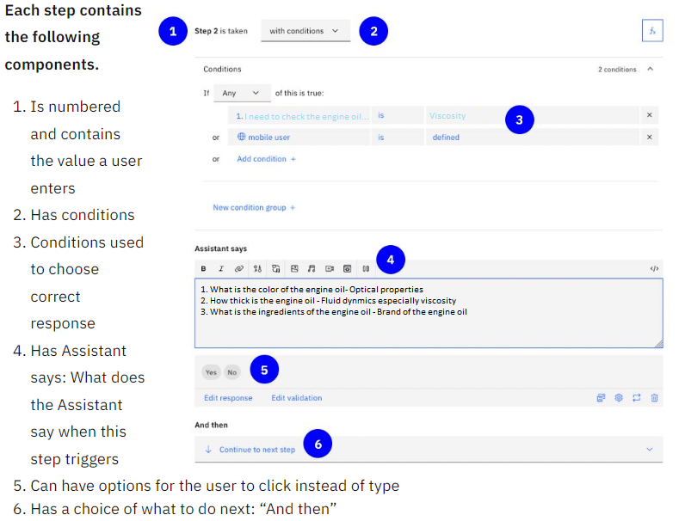


Slide 22
In summary, watsonx Assistant operates like a finely tuned machine, leveraging cognitive AI, deep learning, and transfer learning to handle complex tasks with precision and adaptability.
Each action and step is engineered to minimize friction, optimize performance, and continuously learn from its environment, much like the self-optimizing systems found in advanced mechanical and thermodynamic processes.
Integrating watsonx Assistant into other systems can be compared to integrating various mechanical subsystems into a larger machine or engine, where each component plays a specific role and enhances overall system performance. Each integration point, or channel, functions similarly to different mechanical inputs such as torque, heat, or fluid pressure, influencing the system's output. Here's how this process works across several key domains:
1. Voice Channel Integration
The integration of voice channels with watsonx Assistant is akin to connecting a sensor that converts analog mechanical signals into digital data for processing by a control system. In this case, the analog signal is the caller’s voice, which is captured through Speech-to-Text (STT).
The incoming audio, much like mechanical vibrations or temperature readings, is digitized and interpreted by the system. This digitized text is processed by watsonx to determine the appropriate response.
The response process is similar to a mechanical feedback loop. Once the appropriate action is determined, it is converted back from digital text to analog speech via Text-to-Speech (TTS). This mirrors how control systems convert digital signals into physical outputs, such as actuating a motor or regulating heat. The final response is delivered back to the caller in their original analog form spoken words over the phone.
This process can be fine-tuned, much like calibrating a machine’s performance. The SME can adjust voice parameters such as gender, tone (e.g., empathy, cheerfulness), and regional accents, similar to selecting different operational modes for an engine depending on the environment or load conditions.
Furthermore, the system can be customized for domain-specific languages, similar to how different materials or mechanical systems require different lubrication types or torque levels. The SME can refine the assistant’s understanding of industry-specific terminology by adjusting the waveform, much like tuning a mechanical system for optimized performance based on environmental conditions.

Slide 23
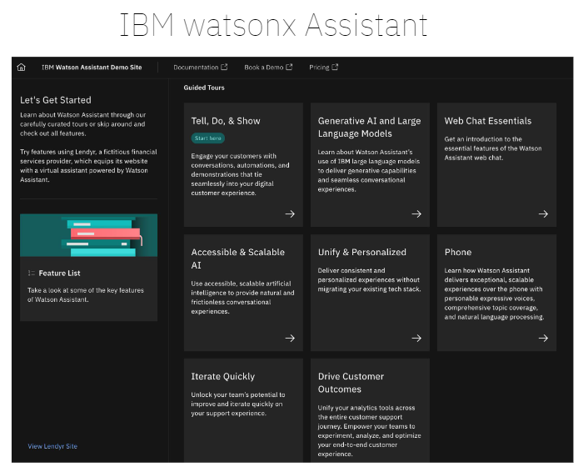

Slide 24
2. Channels
In engineering terms, channels can be viewed as the various input points or interfaces where external forces or signals are applied to a system. Each channel, such as WhatsApp, Slack, or MS Teams, functions similarly to how different torque inputs or heat sources influence a mechanical system.
Once connected, these channels enable seamless interaction between the user and the assistant, without requiring the SME to write any code. This is similar to using a plug-and-play mechanical component that integrates smoothly with an existing system without extensive calibration. The SME simply configures the connection, like setting torque limits on a motor or connecting hydraulic lines, and the assistant becomes operational within that channel.
Example: Web Chat Integration
Using the web console, the SME can modify the assistant’s front-end characteristics in the same way that engineers might adjust the interface or control panel of a machine. This includes changing the assistant’s name, color scheme, or avatar analogous to customizing the exterior design of a machine to match the branding or user interface requirements.
The web chat can be deployed by embedding script code into the company’s website, much like embedding a sensor or actuator into an existing mechanical framework.
The script ensures the assistant operates smoothly within the web environment, just as integrated sensors ensure smooth machine operation.
3. Back-end extensions
Back-end integrations are like connecting a mechanical system’s control unit to external data sources, such as temperature sensors, actuators, or operational databases. The assistant connects to the company's data repositories, such as CRM systems, where it retrieves customer-specific information. This is analogous to how control systems pull sensor data to adjust system parameters like torque, heat, or pressure.
For instance, when the assistant asks for a customer ID, it retrieves relevant data from the back-end, just as an engine control unit (ECU) pulls real-time data from sensors. Based on this data, the assistant can personalize the user’s experience, similar to how an ECU adjusts fuel injection or timing based on real-time sensor feedback.

Slide 25
This personalization process is like pre-populating forms based on known user data, akin to a control system adjusting pre-set operating parameters based on external conditions. It reduces friction in the process, ensuring smooth and efficient operation.
The assistant can also handle different service levels for users based on their membership status in the CRM, similar to how different load conditions in a mechanical system require adjustments in torque or speed. The assistant might present special offers or options, much like a system that optimizes power output or efficiency based on the operational load.
4. Agent Escalation
Agent escalation in watsonx Assistant can be compared to an automated machine detecting an operational fault that requires manual intervention. In engineering, this is analogous to triggering an emergency stop or sending an alert.
From an engineering perspective, the concept of agent escalation in a system like watsonx Assistant can be compared to the management of mechanical stress in complex machinery.
Think of the system as operating under steady state conditions, much like a well-oiled machine where all moving parts, like torque transmission, friction control, and load distribution are in harmony. However, when a critical issue arises, it introduces a high friction scenario, analogous to a sudden load or force applied beyond the designed limits. This calls for a "release valve" an agent escalation to mitigate damage and ensure the system's smooth operation.
Consider a user interacting with the assistant. If they encounter issues, such as reaching their credit card limit or disputing a transaction (similar to mechanical overload), the system identifies a way of alerting a user, similar to a check engine light which appears on car near the speedometer.
In engineering terms, agent escalation within a Watsonx Assistant can be described as the point where the system encounters resistance beyond its designed operational capacity, similar to how mechanical systems face torque limitations or thermal overload. Consider the user as the driving force (input), and the assistant as the system designed to process inputs and generate the required outputs (responses).

Slide 26
When the user presents a problem that exceeds the system's capability, like querying complex or sensitive information, the system experiences friction or operational resistance, analogous to reaching a critical torque or thermodynamic threshold.
This necessitates an escalation to a human agent to alleviate the load, much like activating a mechanical safety valve under pressure to prevent system failure.
For example, when a user asks about a lost credit card, fraud, or a dispute charge, the problem generates too much "friction" for the automated assistant to resolve.
In mechanical terms, this represents a condition where torque exceeds the system’s efficiency rating, resulting in heat accumulation (frustration or lack of resolution).
Here, the assistant is pre-programmed to divert this overload (problem that exceeds the system's capability ), escalating to a human agent to dissipate the friction, similar to how energy is transferred in thermodynamic systems to restore equilibrium.
The assistant’s handling of repeated or unresolved queries mirrors how an engine may stall if friction remains unresolved. When a user types, “my card is hacked,” and the assistant fails to understand, it cycles through incorrect responses.
This repetitive process mimics a loop in a feedback control system, where unrecognized input acts like continuous vibrations in a mechanical structure leading to wear, inefficiency, or damage over time. To prevent this “wear” on user experience, the assistant is equipped with mechanisms like unrecognized input frequency detection, which functions similarly to a governor on a machine, modulating and redirecting the user toward the correct pathway (e.g., transferring to a live agent).
Finally, as in any well-designed system, the assistant doesn’t just hand over control without transferring critical parameters. Before escalating, it passes along the user’s data similar to how sensors in an engineered system send diagnostic data upstream to ensure continuity when the next control stage takes over.
This ensures that the live agent receives all relevant information (e.g., name, account number, tone) so the interaction can resume without resetting or inefficiency.
In summary, agent escalation in a Watsonx Assistant functions like a load-balancing mechanism within a complex engineering system. It redirects tasks when system limits are reached, ensures that operational friction is minimized, and transfers essential "diagnostic" data to human agents, who act as the final stage in resolving user inquiries efficiently.

Slide 27
From an engineering perspective, the deployment of the IBM Watsonx Assistant on the IBM Cloud or as part of an on-premise Cloud Pak for Data solution can be likened to how complex machines integrate various subsystems for optimal performance under specific operational conditions.
The assistant functions as a multi-functional tool, where each deployment method offers specific torque and efficiency levels based on the requirements of the system, much like choosing between hydraulic, pneumatic, or electric drives depending on torque and power needs.
Phone Integration
In this scenario, the assistant is integrated into a phone system, which acts as a communication channel, akin to a transmission system in a machine that converts input energy into usable work.
The voice interaction (via Text to Speech and Speech to Text services) is comparable to a gear assembly, smoothly converting and transferring input and output signals (user voice and assistant responses).
If the torque, or load, becomes too high such as when a user asks to speak to a human, the system transfers this load to a live agent, just as a torque limiter would transfer excess force to prevent system damage.
Microsoft Teams
Embedding the assistant within Microsoft Teams is like integrating a subsystem into a larger network of machines or production lines. Teams becomes a collaborative hub (similar to a central drive shaft) where different components (content, tools, and people) mesh together to complete the user’s task, with the assistant acting as a precision tool designed for specific operations within this interconnected framework.
Web Chat Integration
The web chat integration can be viewed as a customizable interface for controlling an engineered system. The assistant's widget, added to a website, operates like an adaptive user control panel on a machine. You can configure various parameters (appearance, images, colors) to suit operational needs, just as you would fine-tune a machine’s settings for different operating environments.

Slide 28
SMS and MMS Integration
The SMS and MMS functionalities reflect communication protocols with specific bandwidth limitations, much like flow channels in fluid systems. SMS is constrained by message length, similar to how a pipe limits fluid flow, while MMS supports longer messages and multimedia, akin to a larger-diameter pipe allowing for increased throughput.
When paired with Twilio’s MMS message support, it automatically adjusts to the data load, optimizing message transmission just as a flow control valve optimizes fluid pressure.
Facebook Messenger Integration
The integration with Facebook Messenger can be compared to an automated feedback control system, where the assistant waits for the user (input signal) to initiate the conversation. This resembles a sensor-based system in which the control action only begins once a specific input is detected, maintaining system efficiency by preventing unnecessary energy usage during idle states.
Enterprise Administration
In an enterprise deployment, managing the assistant with role-based access control is analogous to governing access to a machine’s controls based on the user’s role and experience level. Authentication and authorization act as safety interlocks, ensuring only qualified personnel can operate or modify critical components of the system, reducing the risk of operational error.
Encryption and Data Protection
Encryption, like the security layers in a machine’s operation, such as heat shields or overload protectors, ensures that data remains secure during transmission and at rest. Technologies like AES-256 encryption can be compared to advanced locking mechanisms that protect sensitive components in a high-risk environment, while transport protocols like HTTPS via TLS act like pressure-rated pipes carrying critical data without leakage.

Slide 29
Backup and Redundancy
The high availability and redundancy of Watsonx services resemble how a robust system employs backup power sources or parallel components to ensure continuous operation even if one subsystem fails. Data replication across multiple data centers acts as the load-sharing between mechanical systems to prevent system-wide failures, much like how engines use multiple cylinders to ensure uninterrupted performance.
Network Security
Watsonx’s "defense-in-depth" strategy is similar to a multi-layered safety mechanism in an engineered system. Each layer whether it’s inspection, detection, or prevention serves as a filter or barrier, analogous to the sequential safety checks and balances in machine operations, ensuring that security breaches are detected and neutralized before they impact the system.
Logs and Monitoring
Logging at each layer in the network stack mirrors how an engineer monitors machine performance through sensors and real-time data logging. Load-balancing and protection mechanisms, like DDoS solutions, serve as surge protectors or pressure-relief valves, preventing overload or failure due to external forces.
Conclusion
The deployment and management of IBM Watsonx Assistant can be thought of as operating a complex engineered system, where each integration (phone, web chat, SMS, etc.) and feature (role-based access, encryption, logs) serves a specific purpose in ensuring smooth, secure, and efficient operation under various load and environmental conditions. By ensuring proper "torque" control (task management), minimizing "friction .

Slide 30
In engineering terms, the personality of an Intelligent Virtual Agent (IVA) can be described as a dynamic system, where different configurations of torque, friction, and system response are applied to match specific user needs and interactions.
Torque and Load Handling in Personality Adjustments: Just as torque in mechanical systems is adjusted based on load, an IVA’s personality must be tuned to handle various levels of user interaction. For example, when the task is light, such as helping a user find copy paper, the IVA can operate with low torque, offering an upbeat and friendly personality that facilitates a smooth and quick transaction. This resembles a motor running at high speed with minimal resistance. In contrast, when handling a report of fraud, the IVA must increase its torque to deal with the higher emotional and cognitive load, becoming more serious and neutral. It's like switching gears to generate more force with slower but steady output, ensuring the system remains stable under higher stress.
Heat Management and Emotional Intensity: Thermodynamic principles apply to how the IVA manages emotional intensity. An agent handling a user’s call after a family death must operate at a lower emotional “temperature,” akin to controlling heat transfer in a system to prevent overheating. This empathetic response is designed to reduce friction in the conversation, allowing for a calm, supportive exchange. On the other hand, an IVA designed to help with quick, transactional tasks like purchasing copy paper can run at a higher emotional temperature, using more energy (enthusiasm) while avoiding user fatigue.
Friction and Communication Style: In mechanical systems, friction must be managed to optimize efficiency. Similarly, an IVA must control the "friction" in its communication style. A friendly, engaging tone with concise responses in a sales context can be compared to a well-lubricated machine that minimizes wear and energy loss. For serious issues like fraud reporting, higher friction is necessary to slow down the process and ensure careful, deliberate communication—like applying brakes to maintain control under challenging conditions.
Personality as Viscosity: The fluidity of the IVA’s responses can be likened to the viscosity of a fluid in a hydraulic system. A playful, witty assistant might behave like a low-viscosity fluid, easily flowing through conversations, making rapid adjustments. In contrast, a more business-like agent has higher viscosity, moving more deliberately, offering structured responses with less deviation, ensuring precision in a formal interaction.

Slide 31
Multiple Channels as Parallel Circuits: Deploying the assistant across various channels (web, SMS, social media) is similar to configuring parallel circuits in electrical systems.
Each channel represents a separate path for information flow, and like current splitting across resistors, the IVA adapts its personality based on the resistance (user expectations and context) it encounters in each platform.
A high-traffic website may require a more automated, streamlined experience (low resistance), whereas voice interactions demand more personal engagement (higher resistance).
Heat Exchanger Model for Personality Consistency: Just like a heat exchanger ensures thermal balance across different parts of a system, the IVA’s personality must remain consistent yet adaptable across different platforms. Whether the interaction occurs via Facebook or phone, the IVA regulates the "emotional temperature" to maintain comfort and efficiency in user interactions.
Feedback Loops and System Stability: The IVA’s personality evolves based on feedback, much like a feedback loop in a control system. User inputs are monitored, and the assistant adjusts its responses to maintain stability in the interaction. This control mechanism ensures that the IVA doesn’t “overheat” (respond too aggressively) or “stall” (become too passive), keeping the conversation on track and productive.
Boolean Logic in Interaction Flow as Circuit Design: The logical flow of the IVA’s conversations is driven by Boolean expressions, similar to circuit logic. Each user input acts like a switch, determining the next state of the system.
The IVA must evaluate conditions (AND/OR logic) to trigger appropriate responses, ensuring the conversation proceeds smoothly without creating bottlenecks or dead ends, much like ensuring the proper flow of current in a well-designed circuit.
In summary, the IVA’s personality is engineered to balance torque, friction, heat management, and fluid dynamics to optimize the user experience.
Whether dealing with light or heavy emotional loads, the system must dynamically adjust its parameters to maintain efficiency, stability, and precision in all interactions.

Slide 32
From an engineering perspective, the process of building an action sequence in an Intelligent Virtual Agent (IVA) can be compared to the design and optimization of a mechanical or control system. Each action is structured as an ordered sequence of steps, where inputs, outputs, conditions, and feedback mechanisms work in harmony to achieve a desired outcome, similar to how mechanical components interact in a well-calibrated machine.
1. Conditions section as load and torque adjustments:
The Conditions Section is equivalent to setting the load limits and torque requirements in a mechanical system. Just as torque needs to be adjusted based on the load for a mechanical device to function optimally, conditions define when specific actions should occur in the system.
For instance, if a user starts with the input "I want to pay a bill," the system senses this as an applied load, triggering the necessary torque (action) to process this input efficiently. This input sets up a range of operating conditions that govern subsequent steps, like setting a variable or displaying a response.
2. Setting variable values as system calibration:
Similar to calibrating a thermodynamic system by setting specific temperature or pressure values, the Set Variable Values Section involves configuring the system for optimal performance.
These variables act like adjustable parameters, fine-tuning the behavior of the IVA, much like tuning the compression ratio in an engine to ensure it performs within safe operational limits. For instance, setting a variable like “account type = savings” adjusts the next actions, ensuring precise responses based on the calibrated input.
3. Assistant says section as input and feedback mechanism:
The Assistant Says Section functions like a feedback loop in a control system, where the system provides information or prompts based on its current state. It is comparable to how an engine provides feedback through RPMs or thermodynamic systems through pressure gauges.
This dialogue output is crucial for user guidance, ensuring that each action step moves smoothly like a machine responding to real-time conditions to prevent excessive friction or loss of efficiency.

Slide 33
4. Customer response as force application and system response:
The Define Customer Response Section represents the external forces acting upon the system, similar to how a user input acts like applying force or torque to a mechanism.
Just as a mechanical system must adjust its operations based on the applied force, the IVA adapts based on the type of input from the user whether it’s free text, numbers, or date selections.
This input is validated, ensuring the system stays within its design parameters, just like validating the force limits to avoid mechanical failure.
5. Options Section as System Constraints:
In engineering terms, the Options Section can be viewed as the frictional elements in a mechanical system that provide necessary resistance to guide the process along a defined path. The pre-set options (such as Yes/No or savings/checking) function like gears, constraining the possible outcomes and ensuring smooth transitions between steps. By limiting the range of responses, the system reduces unnecessary "slip" or loss of control, similar to minimizing friction in gear trains.
6. Step Sequence as Kinematic Motion and Process Flow:
The ordered steps in an action sequence are analogous to a kinematic motion system, where each step is dependent on the previous one, ensuring that the system follows a logical, predefined path of motion. Each step is like a component in a mechanical assembly that, when triggered, causes the next component to move, generating a smooth process flow without interruptions. In this case, the steps are executed based on conditions evaluated through Boolean logic (AND/OR), similar to how mechanical systems use switches and control circuits to control motion.
7. Boolean Expressions as Circuit Logic and Flow Control:
The Boolean expressions that control the flow of actions within the system can be likened to the logic gates in electrical circuits, where inputs control outputs based on specific conditions. In an IVA, these expressions evaluate user input and determine the appropriate path, just as circuits regulate electrical flow based on conditions (voltage or current).
When conditions are met (true), the next step in the sequence is triggered, ensuring an efficient and controlled operation, much like controlling electrical current in a circuit for optimal power flow.

Slide 34
8. And then section as output torque or final system output:
Finally, the And Then Section is equivalent to the output torque or energy release in a mechanical system. It determines the final action or outcome after all conditions are met and steps completed, similar to how a system releases energy at the end of a thermodynamic cycle or how an engine generates torque after completing a combustion process.
The outcome might involve moving to the next step, repeating a question, or performing a sub-action, much like selecting a different gear ratio to achieve varying output torque based on the required task.
In summary, the process of creating an action in an IVA is akin to engineering a well-oiled machine or system. From defining input conditions and controlling variables to guiding the system through sequential steps and optimizing responses, the IVA functions like a dynamic machine.
Each section plays a vital role, ensuring smooth and efficient operation while minimizing friction, managing loads, and delivering precise outputs.
From an engineering perspective, the process of configuring an Intelligent Virtual Agent (IVA), particularly using tools like IBM Watson Assistant, can be likened to designing and optimizing a complex mechanical system with multiple subsystems, where each section of the process plays a role in reducing inefficiencies, balancing forces, and ensuring seamless operation across different platforms.
1. And Then Section as Load Distribution and Energy Transfer:
When the builder sets a sub-action in the And Then Section, it functions similarly to distributing load or transferring energy to a secondary system in mechanical engineering.
Just as energy flows from one subsystem to another to perform a separate task—like redirecting torque in a gearbox, the IVA redirects the user to a sub-action to complete a different task. This action is crucial for system efficiency, ensuring that each "load" (user request) is managed without overburdening any single component.

Slide 35
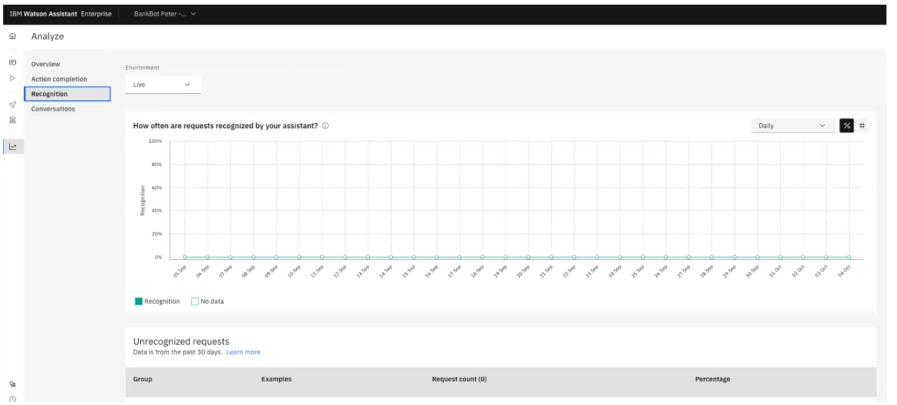

Slide 36
Watsonx assistant has a recognition area where unrecognized requests can be imported directly as an action so you can begin to cover that area. And then we have the integrations catalog. So here you can see your connection to web chat, phone SMS Facebook messenger, the messaging services that I mentioned earlier.
There is a new Assistant Builder in watsonx Orchestrate, with the assistants that has been prebuilt comprising of watsonx Assistant for Z, with Code Assistant, or with the way it is embedded in key applications.

Slide 37
2. Rearranging Steps as adjusting gear Alignment:
If a step is placed incorrectly, it's akin to misalignment in a system of gears or pulleys. When this happens, it causes friction or inefficiency in the system, reducing its effectiveness. The drag-and-drop feature for rearranging steps mirrors adjusting the gear teeth for proper meshing, ensuring minimal frictional losses and smooth operation throughout the process.
Previewing the action sequence is like running a simulation or a thermal test to ensure optimal energy transfer and minimal wear in the system.
3. Data Storage as Kinetic Energy Recovery and Reuse:
Each user input stored within the action can be reused, similar to how mechanical systems employ kinetic energy recovery systems (KERS). Just as energy is captured during braking in KERS and reused to improve efficiency, the IVA stores input data from earlier steps to optimize subsequent actions, ensuring the process remains efficient without redundant energy expenditure (or redundant prompts).
4. Chatbots as Single-Stage Engines:
Chatbots can be compared to a single-stage thermodynamic engine, capable of handling straightforward tasks such as “play Mozart’s 5th,” similar to how an engine might perform a simple task like powering a single drive shaft.
These chatbots operate within limited proprietary systems—much like engines specifically designed for a certain type of fuel or environment. They can interpret basic user input using AI, similar to how an engine interprets external forces like heat or pressure to perform work.
5. ChatGPT as an uncalibrated system:
ChatGPT, in this context, can be likened to an uncalibrated, all-purpose machine that lacks specific control mechanisms to fine-tune for a particular application. It’s a powerful system, but like a high-powered engine that hasn’t been optimized for a particular fuel mixture or torque range, its generalized data sets can result in inefficiencies or even poor performance when precision is required.
Without backend integration or domain-specific adjustments, its output is less controlled, much like an engine running on unpredictable fuel quality leading to inconsistent results.

Slide 38
6. IVA as a multi-stage powerplant:
An Intelligent Virtual Agent (IVA) is more analogous to a sophisticated multi-stage powerplant, capable of handling high-efficiency, multi-load tasks. It uses precise control mechanisms (AI/ML) that, much like valves and pressure regulators, ensure that each subsystem is fine-tuned to achieve maximum performance.
IVAs can integrate with both front-end (external channels) and back-end (data systems) seamlessly, much like how a powerplant is integrated with both a fuel source and energy distribution network.
7. Multi-Platform Deployment as Torque Transfer Across Gear Networks:
Deploying IVAs across multiple platforms, such as Facebook, SMS, and phone systems, is equivalent to transferring torque across different gear systems in an industrial machine.
Each platform requires the IVA to adapt, just as torque must be adjusted based on the gear ratio to maintain efficient performance.
The IVA can "shift gears" depending on the user’s platform, providing the same high-level functionality across diverse environments without losing efficiency or creating unnecessary friction.
8. Back-End Extensions as System Integration:
The ability of IVAs to connect to private or public REST applications is similar to integrating various subsystems in a mechanical or thermodynamic system.
For example, in a complex hydraulic system, various pumps, valves, and pressure regulators must work together seamlessly. Similarly, back-end extensions enable the IVA to communicate with different databases, proprietary systems, or external APIs, ensuring that information flows as smoothly as hydraulic fluid within a well-designed system.

Slide 39
9. Use Cases as Specialized Machines in Various Industries:
The use cases of IVAs can be compared to applying specialized machines across different industries. For example:
Law: An IVA acts like a precision tool, similar to a lathe used in manufacturing to make intricate cuts. The IVA continuously updates and refines its knowledge, adapting to changes in legal codes like a lathe being fine-tuned for new materials.
Banking: IVAs in fraud detection function similarly to sensors in industrial machines that monitor torque or pressure changes. They flag anomalies that could indicate system malfunctions (fraud), preventing damage or catastrophic failures in the system.
RegTech: In regulatory technology, IVAs behave like complex monitoring systems that track vibrations or heat in a mechanical system, identifying outliers (like insider trading or financial crimes) before they cause irreversible damage.
10. Lifecycle Management and Analytics as Predictive Maintenance:
The Lifecycle Management and Analytics capabilities of IVAs align with predictive maintenance in engineering. Just as predictive maintenance uses data analytics to foresee mechanical failures, IVAs use their built-in analytics tools to monitor user interactions, detect patterns, and make adjustments, ensuring the system continues to operate at peak performance.
In conclusion, the design and deployment of an IVA mirrors many principles from mechanical and systems engineering.
From optimizing friction and reducing energy loss to integrating with multiple platforms and ensuring seamless operation, the process follows a rigorous structure akin to fine-tuning an industrial machine.
Each component, from user inputs to platform integration, functions like a well-coordinated system with precise control over its outputs.
From an engineering perspective, the concept of tailoring the personality of an Intelligent Virtual Agent (IVA) can be compared to adjusting the parameters of a complex mechanical system to optimize performance for different operating conditions.

Slide 40
Summary
1. Personality as System Tuning and Calibration:
Just like tuning an engine to handle varying loads, temperatures, or torque demands, the personality of an IVA must be calibrated based on the specific context and task. For instance:
An upbeat and energetic IVA assisting with checking inventory or making a purchase is like a high-torque motor designed for quick, efficient output in low-friction environments.
An empathetic personality, used for sensitive situations (e.g., life insurance inquiries after a death), can be likened to a precision-engineered damping system that carefully modulates force, reducing friction and shock to handle delicate situations with minimal impact.
In both cases, the goal is to reduce resistance (emotional friction) and maximize efficiency by aligning the IVA's behavior with the emotional and practical needs of the user.
2. Agent Deployment as Load Distribution Across Platforms:
The placement of an IVA across various platforms such as SMS is akin to distributing mechanical load across multiple gears or shafts in a machine. Just as engineers must account for how torque is transmitted and distributed in a drivetrain, businesses must consider where their customers are "located" to ensure optimal performance and accessibility of the IVA.
For example, deploying the IVA on Facebook, where the load is customer interaction, is like setting a drive shaft to handle a specific torque range. The IVA must be equipped with the appropriate "torque" (integration capabilities) to meet the demands of the user in that environment.
3. Building an IVA as Assembling a Modular System:
The process of constructing an IVA using Watson Assistant can be compared to assembling a modular mechanical system where all the necessary components (e.g., AI, natural language understanding, and machine learning) are already built-in, much like standardized parts in a machine kit. In this scenario, the Subject Matter Expert (SME) functions as the system integrator, someone who knows the specific application (customer needs) and how to assemble the modules (pre-built AI components) for optimal performance.

Slide 41
No advanced engineering knowledge (like machine learning or AI expertise) is required, just as you wouldn't need to redesign components when using pre-manufactured parts.
The focus is on assembling the system to meet specific operational requirements.
4. Chatbots vs. IVAs: Single-Stage vs. Multi-Stage Machines:
Basic chatbots are like single-stage machines performing simple, repetitive tasks, such as raising the thermostat or playing music. These bots function much like a single-speed motor that delivers a fixed output, designed for simple, well-defined loads.
On the other hand, an IVA represents a more complex multi-stage system capable of handling variable loads and integrating multiple control systems.
This is similar to a multi-stage turbine, which adjusts its power output based on the operational environment, seamlessly integrating phone, text, and back-end data sources for enterprise-level operations.
5. Channels as Torque Transmission Pathways:
The various channels or integrations available for the IVA (e.g., websites, SMS, Teams) can be compared to the pathways through which torque is transmitted in a mechanical system. Different channels present unique resistances (platform-specific constraints), just as different gear systems or belts create frictional losses or efficiency variations.
The IVA must adapt to these different environments, seamlessly adjusting its "torque" (communication style, data processing) to ensure smooth operation across multiple platforms without losing efficiency.
6. Back-End Extensions as System Integration with Auxiliary Devices:
Just as complex mechanical systems often integrate auxiliary devices similar to sensors or regulators so as to monitor and control specific subsystems, IVAs must integrate with back-end systems to perform tasks such as checking customer balances or making payments. These integrations act like sensors and actuators in an industrial control system, responding to user input and executing actions based on real-time data.

Slide 42
The ease with which these extensions can be connected to the IVA mirrors how standardized auxiliary devices can be integrated into larger systems, optimizing overall performance without the need for extensive customization.
7. Multibot Orchestration as Parallel Processing Units:
Multibot orchestration can be thought of as the coordination between multiple parallel processing units or subsystems within a larger system. When a primary virtual agent oversees multiple sub-agents, it functions like a central controller distributing torque across different shafts in a transmission system.
For example, a user interacting with a vacation-planning IVA would navigate between flights, hotels, and car rentals, just as torque is directed to different gears based on load requirements in a mechanical system. The primary IVA ensures smooth transitions between these tasks, maintaining system integrity and avoiding operational friction (user confusion or inefficiency).
8. Voice and Text Integration as a Variable Speed Transmission:
The ability for a user to switch between voice and text is analogous to a variable-speed transmission that can shift gears between different torque demands.
In this case, the IVA adjusts its communication medium based on the user's input (voice or text), just as a transmission shifts gears to match the required torque or speed. This flexibility ensures the system operates efficiently, regardless of the load (medium) placed on it by the user.
9. Analytics as Predictive Maintenance:
Built-in analytics in the IVA, which track user behavior, measure confidence scores, and compare performance across environments, is similar to predictive maintenance systems in engineering.
Just as data from sensors is used to predict when a machine part will fail, IVA analytics gather data on user interactions to fine-tune the system, ensuring optimal performance and preventing breakdowns (customer dissatisfaction).

Slide 43
These analytics allow for continuous improvement, much like condition-based monitoring in a mechanical system, ensuring that the IVA remains aligned with user needs and operational conditions.
10. Foundation Models as Pre-Tuned Engines:
The foundation models built into Watson Assistant can be likened to pre-tuned engines designed for optimal performance under specific operating conditions. These models come with state-of-the-art features, like few-shot learning and transfer learning, akin to an engine pre-calibrated to handle different fuel mixtures or load conditions.
Just as engineers adjust the tuning of an engine based on real-world performance data, these foundation models adapt to different user inputs and scenarios, ensuring consistent, reliable performance in a variety of environments.
Conclusion:
The engineering analogy of building and managing an IVA with Watson Assistant involves optimizing the system for varying loads, friction, and operational conditions.
From configuring personality (system tuning) to deploying on multiple platforms (load distribution) and integrating back-end systems (auxiliary device connections), the process is akin to designing a highly efficient, multi-stage machine that can handle diverse operational requirements with precision and adaptability.

Slide 44
IBM recently formulated a watsonx Code Assistant, with an initial focus on Ansible and then on Z, which is focused on COBOL applications.
IBM created a watsonx Code Assistant for Z, they took a full lifecycle focus to understand applications, quickly explain what they do, translate key application components into other languages, in this case Java, and deploy them successfully.
It is basically a watsonx Code Assistant for Java Enterprise applications.
These apps that we all run somewhere on WebSphere Application Servers.
The objective is to modernize them or use and understand them in more effective ways. The power of generative AI is in how it allows us to start working through this cycle, to observe, build, and understand by explaining the applications.
Understanding the application leads to important considerations, such as update planning or key factors to keep in mind regarding it. The assistant can identify issues early and provide instructions to fix them.
AI is great at building automatically generated test cases that match the issues and key factors to keep in mind. And once that's done, why not ask the assistant to quickly summarize all the key changes that have occurred in the environment,
Moreover there is a new Assistant Builder in watsonx Orchestrate, with the assistants that have been prebuilt for in watsonx Assistant for Z, with Code Assistant, or with the way they are embedded in key applications.
This ensures that a user is able to start getting a sense of what productivity at scale with AI assistants means.
In summary it is essential to have an AI assistant honed by the data you already trust, because the right answers are a must, that integrates with your software and platforms. This would be an assistant truly engineered for performance, allowing your customers to get the answers they need instead of waiting, developers to accelerate delivery times, and your team to shine. It is crucial to build an AI assistant that accelerates the way a team works.
We often find ourselves asking colleagues to help us with a certain task, and we like to interact with systems in the same conversational style. With intelligent automations, AI assistants also help us free ourselves from repetitive tasks, enable self-service work, and allow us to connect work across multiple stages and processes.
In the context of the transformation of business process automation, also called digital work, in the well-established realm of customer service or even in code development, AI assistants are demonstrating significant value.

